Slide 1

Faculty of Information Technology, Monash University

Slide 2
FIT2004: Algorithms and Data Structures
Week 9: Bellman-Ford and Floyd-Warshall Algorithms
These slides are prepared by M. A. Cheema and are based on the material developed by Arun Konagurthu and Lloyd Allison.

Slide 3
Recommended reading
Unit notes: Chapter 13
Cormen et al. Introduction to Algorithms.
Section 24.1: Bellman-Ford algorithm
Section 25.2: Floyd-Warshall algorithm
Student Evaluation of Teaching and Units is now open

Slide 4
Outline
Shortest path in graphs with negative weights
All-pairs shortest paths
Transitive Closure

Slide 5
Shortest path (negative weights)
What is the shortest distance from s to v in this graph?
If Dijkstra’s algorithm is used on this graph, what will it output as being the shortest path from s to v?
Dijkstra’s algorithm is not guaranteed to output the correct answer when there are negative weights.
6
u
s
-4
3
v

Slide 6
Shortest path (negative weights)
What is the shortest distance from s to v in this graph?
If Dijkstra’s algorithm is used on this graph, what will it output as being the shortest path from s to v?
Dijkstra’s algorithm is not guaranteed to output the correct answer when there are negative weights.
6
u
s
-4
3
v

Slide 7
Shortest path (negative weights)
What is the shortest distance from s to v in this graph?
If Dijkstra’s algorithm is used on this graph, what will it output as being the shortest path from s to v?
Dijkstra’s algorithm is not guaranteed to output the correct answer when there are negative weights.
6
u
s
-4
3
v

Slide 8
Shortest path (negative weights)
What is the shortest distance from s to x in this graph?
5
6
u
- 2
t
-3
s
4
7
- 4
7
v
x
9

Slide 9
Shortest path (negative weights)
What is the shortest distance from s to x in this graph?
Not well-defined:
From s, it is possible to reach the negative cycle u-->v-->t, and from this cycle it is possible to reach x.
Given any path P, it is possible to obtain an alternative path P’ with smaller total weight than P: P’ goes from s to the negative cycle, include as many repetitions of the negative cycle as necessary, and then reaches x from the negative cycle.
5
6
u
- 2
t
-3
s
4
7
- 4
7
v
x
9

Slide 10
Bellman-Ford Algorithm
Bellman-Ford algorithm returns:
shortest distances from s to all vertices in the graph if there are no negative cycles that are reachable from s.
an error if there is a negative cycle reachable from s (i.e., can be used to detect negative cycles).
Can be modified to return all valid shortest distances, and minus ∞ for vertices which are affected by the negative cycle.

Slide 11
Bellman-Ford Algorithm
Idea: If no negative cycles are reachable from node s, then for every node t that is reachable from s there is a shortest path from s to t that is simple (i.e., no nodes are repeated).
Cycles with positive weight cannot be part of a shortest path.
Given a shortest path that contains cycles of weight 0, the cycles can be removed to obtain an alternative shortest path that is simple.
Note that any simple path has at most V-1 edges.

Slide 12
Bellman-Ford Algorithm
A fact from last week: If P is a shortest path from s to u, and v is the last vertex on P before u, then the part of P from s to v is also a shortest path.
Suppose there was a shorter path from s to v, say Q.
weight(Q) + w(v,u) < weight(P)
But P is the shortest path from s to u.
Contradiction
Q
s
v
u
P

Slide 13
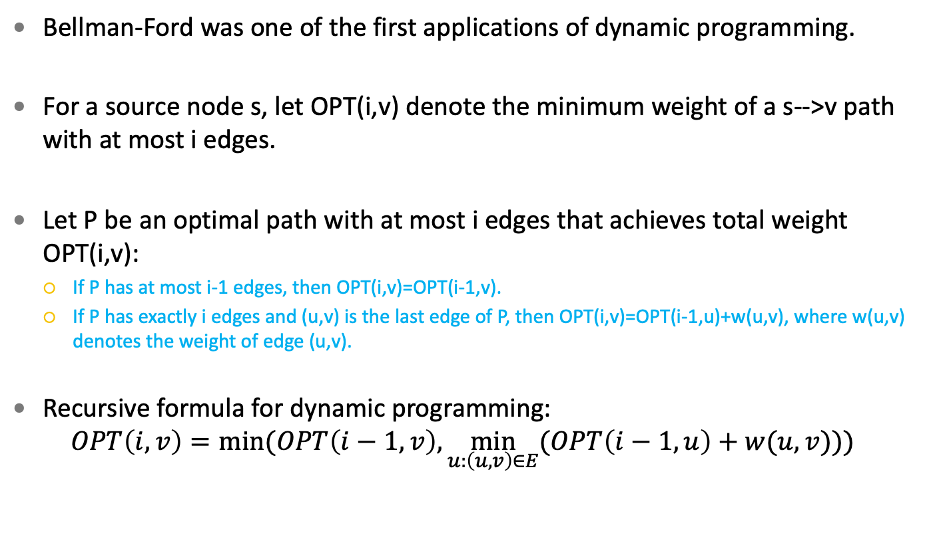
Bellman-Ford Algorithm
Bellman-Ford was one of the first applications of dynamic programming.
For a source node s, let OPT(i,v) denote the minimum weight of a s-->v path with at most i edges.
Let P be an optimal path with at most i edges that achieves total weight OPT(i,v):
If P has at most i-1 edges, then OPT(i,v)=OPT(i-1,v).
If P has exactly i edges and (u,v) is the last edge of P, then OPT(i,v)=OPT(i-1,u)+w(u,v), where w(u,v) denotes the weight of edge (u,v).
Recursive formula for dynamic programming:
$$OPT\left(i,v\right)=min⁡(OPT\left(i−1,v\right),\min_{u:\left(u,v\right)∈E}{(OPT\left(i−1,u\right)+w(u,v)))}⁡$$

Slide 14
Bellman-Ford Algorithm
Uses array M[0...V-1,1...V]
Initialize M[0,s] = 0, for all other vertices M[0,v] = infinity
for i = 1 to V-1:
for each vertex v:
Compute M[i,v] using the recurrence
return M[V-1,1...V]
Time Complexity:
O(VE)

Slide 15
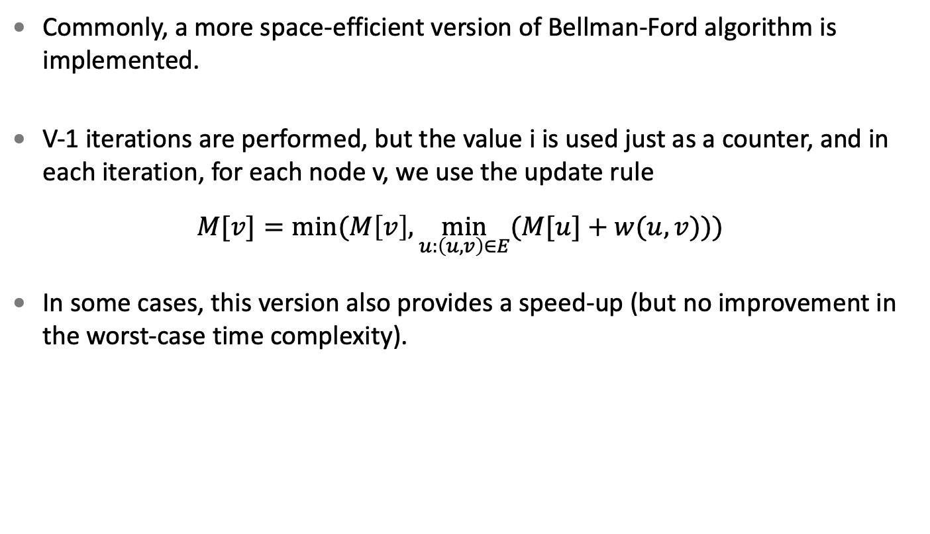
Bellman-Ford Algorithm
Commonly, a more space-efficient version of Bellman-Ford algorithm is implemented.
V-1 iterations are performed, but the value i is used just as a counter, and in each iteration, for each node v, we use the update rule
$$M[v]=min⁡(M\left[v\right],\min_{u:\left(u,v\right)∈E}{(M[u]+w(u,v)))}⁡$$
In some cases, this version also provides a speed-up (but no improvement in the worst-case time complexity).

Slide 16
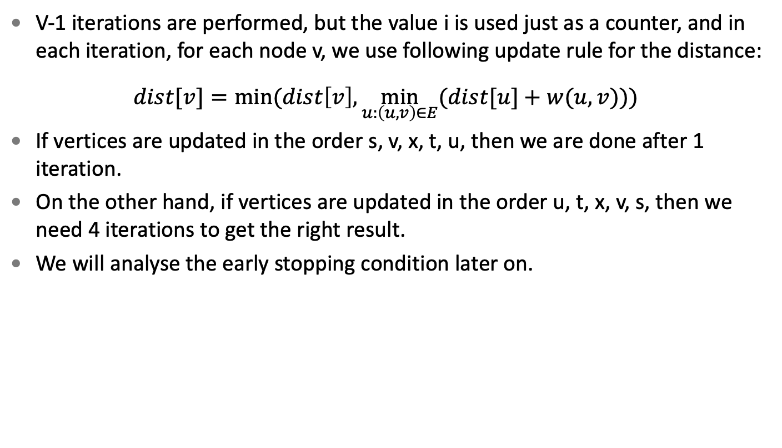
Bellman-Ford Algorithm
V-1 iterations are performed, but the value i is used just as a counter, and in each iteration, for each node v, we use following update rule for the distance:
$$dist[v]=min⁡(dist\left[v\right],\min_{u:\left(u,v\right)∈E}{(dist[u]+w(u,v)))}⁡$$
If vertices are updated in the order s, v, x, t, u, then we are done after 1 iteration.
On the other hand, if vertices are updated in the order u, t, x, v, s, then we need 4 iterations to get the right result.
We will analyse the early stopping condition later on.
u
- 2
t
s
7
7
v
x
9

Slide 17
Bellman-Ford Algorithm
Initialize:
For each vertex a in the graph
dist(s,a) = ∞
dist(s,s) = 0
Consider the following operation (relaxation):
For each edge (a, b) in the graph
dist(s, b) = min(dist(s,b) , dist(s,a) + w(a,b))
∞
∞
5
6
u
- 2
t
-3
0
s
8
7
- 4
Assume the following order:
(s,u), (t,u), (s,v), (u,v), (u,t), (v,t), (x,t), (u,x), (v,x)
7
v
x
∞
9
∞

Slide 18
Bellman-Ford Algorithm
First iteration:
Relaxing incoming edges of node u
∞
∞
5
6
u
- 2
t
-3
0
s
8
7
- 4
Assume the following order:
(s,u), (t,u), (s,v), (u,v), (u,t), (v,t), (x,t), (u,x), (v,x)
7
v
x
∞
9
∞

Slide 19
Bellman-Ford Algorithm
First iteration:
Done relaxing incoming edges of node u
6
∞
5
6
u
- 2
t
-3
0
s
8
7
- 4
Assume the following order:
(s,u), (t,u), (s,v), (u,v), (u,t), (v,t), (x,t), (u,x), (v,x)
7
v
x
∞
9
∞

Slide 20
Bellman-Ford Algorithm
First iteration:
Relaxing incoming edges of node v
6
∞
5
6
u
- 2
t
-3
0
s
8
7
- 4
Assume the following order:
(s,u), (t,u), (s,v), (u,v), (u,t), (v,t), (x,t), (u,x), (v,x)
7
v
x
∞
9
∞

Slide 21
Bellman-Ford Algorithm
First iteration:
Done relaxing incoming edges of node v
6
∞
5
6
u
- 2
t
-3
0
s
8
7
- 4
Assume the following order:
(s,u), (t,u), (s,v), (u,v), (u,t), (v,t), (x,t), (u,x), (v,x)
7
v
x
7
9
∞

Slide 22
Bellman-Ford Algorithm
First iteration:
Relaxing incoming edges of node t
6
∞
5
6
u
- 2
t
-3
0
s
8
7
- 4
Assume the following order:
(s,u), (t,u), (s,v), (u,v), (u,t), (v,t), (x,t), (u,x), (v,x)
7
v
x
7
9
∞

Slide 23
Bellman-Ford Algorithm
First iteration:
Done relaxing incoming edges of node t
6
4
5
6
u
- 2
t
-3
0
s
8
7
- 4
Assume the following order:
(s,u), (t,u), (s,v), (u,v), (u,t), (v,t), (x,t), (u,x), (v,x)
7
v
x
7
9
∞

Slide 24
Bellman-Ford Algorithm
First iteration:
Relaxing incoming edges of node x
6
4
5
6
u
- 2
t
-3
0
s
8
7
- 4
Assume the following order:
(s,u), (t,u), (s,v), (u,v), (u,t), (v,t), (x,t), (u,x), (v,x)
7
v
x
7
9
∞

Slide 25
Bellman-Ford Algorithm
First iteration:
Done relaxing incoming edges of node x
6
4
5
6
u
- 2
t
-3
0
s
8
7
- 4
Assume the following order:
(s,u), (t,u), (s,v), (u,v), (u,t), (v,t), (x,t), (u,x), (v,x)
7
v
x
7
9
2

Slide 26
Bellman-Ford Algorithm
First iteration finished:
6
4
5
6
u
- 2
t
-3
0
s
8
7
- 4
Assume the following order:
(s,u), (t,u), (s,v), (u,v), (u,t), (v,t), (x,t), (u,x), (v,x)
7
v
x
7
9
2

Slide 27
Bellman-Ford Algorithm
Second iteration:
Relaxing incoming edges of node u
6
4
5
6
u
- 2
t
-3
0
s
8
7
- 4
Assume the following order:
(s,u), (t,u), (s,v), (u,v), (u,t), (v,t), (x,t), (u,x), (v,x)
7
v
x
7
9
2

Slide 28
Bellman-Ford Algorithm
Second iteration:
Done relaxing incoming edges of node u
2
4
5
6
u
- 2
t
-3
0
s
8
7
- 4
Assume the following order:
(s,u), (t,u), (s,v), (u,v), (u,t), (v,t), (x,t), (u,x), (v,x)
7
v
x
7
9
2

Slide 29
Bellman-Ford Algorithm
Second iteration:
Relaxing incoming edges of node v
2
4
5
6
u
- 2
t
-3
0
s
8
7
- 4
Assume the following order:
(s,u), (t,u), (s,v), (u,v), (u,t), (v,t), (x,t), (u,x), (v,x)
7
v
x
7
9
2

Slide 30
Bellman-Ford Algorithm
Second iteration:
Done relaxing incoming edges of node v
2
4
5
6
u
- 2
t
-3
0
s
8
7
- 4
Assume the following order:
(s,u), (t,u), (s,v), (u,v), (u,t), (v,t), (x,t), (u,x), (v,x)
7
v
x
7
9
2

Slide 31
Bellman-Ford Algorithm
Second iteration:
Relaxing incoming edges of node t
2
4
5
6
u
- 2
t
-3
0
s
8
7
- 4
Assume the following order:
(s,u), (t,u), (s,v), (u,v), (u,t), (v,t), (x,t), (u,x), (v,x)
7
v
x
7
9
2

Slide 32
Bellman-Ford Algorithm
Second iteration:
Done Relaxing incoming edges of node t
2
4
5
6
u
- 2
t
-3
0
s
8
7
- 4
Assume the following order:
(s,u), (t,u), (s,v), (u,v), (u,t), (v,t), (x,t), (u,x), (v,x)
7
v
x
7
9
2

Slide 33
Bellman-Ford Algorithm
Second iteration:
Relaxing incoming edges of node x
2
4
5
6
u
- 2
t
-3
0
s
8
7
- 4
Assume the following order:
(s,u), (t,u), (s,v), (u,v), (u,t), (v,t), (x,t), (u,x), (v,x)
7
v
x
7
9
2

Slide 34
Bellman-Ford Algorithm
Second iteration:
Done Relaxing incoming edges of node x
2
4
5
6
u
- 2
t
-3
0
s
8
7
- 4
Assume the following order:
(s,u), (t,u), (s,v), (u,v), (u,t), (v,t), (x,t), (u,x), (v,x)
7
v
x
7
9
-2

Slide 35
Bellman-Ford Algorithm
Second iteration finished:
2
4
5
6
u
- 2
t
-3
0
s
8
7
- 4
Assume the following order:
(s,u), (t,u), (s,v), (u,v), (u,t), (v,t), (x,t), (u,x), (v,x)
7
v
x
7
9
-2

Slide 36
Bellman-Ford Algorithm
Third iteration:
Speeding things up: All edges relaxation in the third iteration do not change anything.
Early Stop Condition: If nothing changes in one iteration, it is possible to stop the execution of the Bellman-Ford algorithm and output the current values.
2
4
5
6
u
- 2
t
-3
0
s
8
7
- 4
Assume the following order:
(s,u), (t,u), (s,v), (u,v), (u,t), (v,t), (x,t), (u,x), (v,x)
7
v
x
7
9
-2

Slide 37
Bellman-Ford Algorithm: Negative Cycles
If V-th iteration reduces the distance of a vertex, this means that there is a shorter path with at least V edges which implies that there is a negative cycle.
Consider the graph with vertices s, u, v, and t and assume we have run (V-1 = 3) iterations.
In the 4th iteration, the weight of at least one vertex will be reduced (due to the presence of a negative cycle).
Important: Bellman-Ford Algorithm finds negative cycles only if such cycle is reachable from the source vertex
E.g., if x is the source vertex, the algorithm will not detect the negative cycle
Detecting if a graph G has a negative cycle: just add one extra node to G and edges from it to every other node, and run Bellman-Ford on the added node.
0
z
0
2
4
0
u
t
0
- 2
0
0
s
4
-3
7
v
9
x
7
6

Slide 38
Bellman-Ford Algorithm
# STEP 1: Initializations
dist[1...V] = infinity
pred[1...V] = Null
dist[s] = 0
# STEP 2: Iteratively estimate dist[v] (from source s)
for i = 1 to V-1:
for each edge <u,v> in the whole graph:
est = dist[u] + w(u,v)
if est < dist[v]:
dist[v] = est
pred[v] = u
# STEP 3: Checks and returns false if a negative weight cycle
# is along the path from s to any other vertex
for each edge <u,v> in the whole graph:
if dist[u]+w(u,v) < dist[v] :
return error; # negative edge cylce found in this graph
return dist[...], pred[...]
Time Complexity:
O(VE)

Slide 39
Bellman-Ford Algorithm
For this space-efficient version of Bellman-Ford algorithm, there is a guarantee that after i iterations dist[v] is no larger than the total weight of the shortest path from s to v that uses at most i edges.
But there is no guarantee that these two values are equal after i iterations: depending on the order in which the edges are relaxed, the path P from s to v that has weight dist[v] could already contain more than i edges after the i-th iteration.
e.g., in the graph that we followed a detailed execution of Bellman-Ford, the path from s to t already has two edges after just one iteration.
6
4
5
6
u
- 2
t
-3
0
s
8
7
- 4
7
v
x
7
9
2

Slide 40
Bellman-Ford Algorithm: Negative Cycles
How could we modify Bellman-Ford to determine which vertices have valid distances, and which are affected by the negative cycle?
Execute the Vth iteration, and for each node whose distance would be updated, just mark its distance as -∞.

Slide 41
Outline
Shortest path in a graph with negative weights
All-pairs shortest paths
Transitive Closure

Slide 42
All-Pairs Shortest Paths
Problem
Return shortest distances between all pairs of vertices in a connected graph.
For unweighted graphs:
For each vertex v in the graph
Call Breadth-First Search for v
Time complexity:
O(V(V+E)) = O(V² + EV) ➔ O(EV) [for connected graphs O(V) ≤ O(E)]
For dense graphs: E is O(V²), therefore total cost is O(V³ ) for dense graphs

Slide 43
All-Pairs Shortest Paths
For weighted graphs (with non-negative weights):
For each vertex v in the graph
Call Dijkstra’s algorithm for v
Time complexity:
O(V(E log V)) = O(EV log V)
For dense graphs: O(V³ log V)

Slide 44
All-Pairs Shortest Paths
For weighted graphs (allowing negative weights):
For each vertex v in the graph
Call Bellman-Ford algorithm for v
Time complexity:
O(V(VE)) = O(V² E)
For dense graphs: O(V⁴ )
Can we do better?
Yes, Floyd-Warshall Algorithm returns all-pairs shortest distances in O(V³ ) for graphs allowing negative weights.

Slide 45
Floyd-Warshall Algorithm
Algorithm based on dynamic programming.
If the graph has a negative cycle, it will always be detected.
For a graph without negative cycles, after the k-th iteration, dist[i][j] contains the weight of the shortest path from node i to node j that only uses intermediate nodes from the set {1,…, k}.

Slide 46
Floyd-Warshall Algorithm
Initialize adjacency matrix called dist[][] considering adjacent edges only
For each vertex k in the graph
For each pair of vertices i and j in the graph
If dist(i → k → j) is smaller than the current dist(i→j)
Update/create shortcut i →j with weight equal to dist(i→k→j)
i.e., update dist[i][j] = dist[i][k] + dist[k][j]
Assume that the outer for-loop will access vertices in the order A, B, C, D
First iteration of outer loop (i.e., k is A):
 | A | B | C | D
A | 0 | Inf | -2 | Inf
B | 4 | 0 | 3 | Inf
C | Inf | Inf | 0 | 2
D | Inf | -1 | Inf | 0
-2
C
2
A
3
D
4
-1
B

Slide 47
Floyd-Warshall Algorithm
Initialize adjacency matrix called dist[][] considering adjacent edges only
For each vertex k in the graph
For each pair of vertices i and j in the graph
If dist(i → k → j) is smaller than the current dist(i→j)
Update/create shortcut i →j with weight equal to dist(i→k→j)
i.e., update dist[i][j] = dist[i][k] + dist[k][j]
Assume that the outer for-loop will access vertices in the order A, B, C, D
First iteration of outer loop (i.e., k is A):
 | A | B | C | D
A | 0 | Inf | -2 | Inf
B | 4 | 0 | 3 | Inf
C | Inf | Inf | 0 | 2
D | Inf | -1 | Inf | 0
-2
C
2
A
3
D
4
-1
B

Slide 48
Floyd-Warshall Algorithm
Initialize adjacency matrix called dist[][] considering adjacent edges only
For each vertex k in the graph
For each pair of vertices i and j in the graph
If dist(i → k → j) is smaller than the current dist(i→j)
Update/create shortcut i →j with weight equal to dist(i→k→j)
i.e., update dist[i][j] = dist[i][k] + dist[k][j]
Assume that the outer for-loop will access vertices in the order A, B, C, D
First iteration of outer loop (i.e., k is A):
 | A | B | C | D
A | 0 | Inf | -2 | Inf
B | 4 | 0 | 2 | Inf
C | Inf | Inf | 0 | 2
D | Inf | -1 | Inf | 0
-2
C
2
A
3
D
4
-1
B

Slide 49
Floyd-Warshall Algorithm
Initialize adjacency matrix called dist[][] considering adjacent edges only
For each vertex k in the graph
For each pair of vertices i and j in the graph
If dist(i → k → j) is smaller than the current dist(i→j)
Update/create shortcut i →j with weight equal to dist(i→k→j)
i.e., update dist[i][j] = dist[i][k] + dist[k][j]
Assume that the outer for-loop will access vertices in the order A, B, C, D
First iteration of outer loop (i.e., k is A):
 | A | B | C | D
A | 0 | Inf | -2 | Inf
B | 4 | 0 | 2 | Inf
C | Inf | Inf | 0 | 2
D | Inf | -1 | Inf | 0
-2
C
2
A
3
D
4
-1
B

Slide 50
Floyd-Warshall Algorithm
Initialize adjacency matrix called dist[][] considering adjacent edges only
For each vertex k in the graph
For each pair of vertices i and j in the graph
If dist(i → k → j) is smaller than the current dist(i→j)
Update/create shortcut i →j with weight equal to dist(i→k→j)
i.e., update dist[i][j] = dist[i][k] + dist[k][j]
Assume that the outer for-loop will access vertices in the order A, B, C, D
First iteration of outer loop (i.e., k is A):
BA exists, but AD is currently inf, so we cannot update BD
 | A | B | C | D
A | 0 | Inf | -2 | Inf
B | 4 | 0 | 2 | Inf
C | Inf | Inf | 0 | 2
D | Inf | -1 | Inf | 0
-2
C
2
A
3
D
4
-1
B

Slide 51
Floyd-Warshall Algorithm
Initialize adjacency matrix called dist[][] considering adjacent edges only
For each vertex k in the graph
For each pair of vertices i and j in the graph
If dist(i → k → j) is smaller than the current dist(i→j)
Update/create shortcut i →j with weight equal to dist(i→k→j)
i.e., update dist[i][j] = dist[i][k] + dist[k][j]
Assume that the outer for-loop will access vertices in the order A, B, C, D
First iteration of outer loop (i.e., k is A):
It is not possible to improve the distance between any other pair of nodes using only A as intermediate.
 | A | B | C | D
A | 0 | Inf | -2 | Inf
B | 4 | 0 | 2 | Inf
C | Inf | Inf | 0 | 2
D | Inf | -1 | Inf | 0
-2
C
2
A
3
D
4
-1
B

Slide 52
Floyd-Warshall Algorithm
Initialize adjacency matrix called dist[][] considering adjacent edges only
For each vertex k in the graph
For each pair of vertices i and j in the graph
If dist(i → k → j) is smaller than the current dist(i→j)
Update/create shortcut i →j with weight equal to dist(i→k→j)
i.e., update dist[i][j] = dist[i][k] + dist[k][j]
Assume that the outer for-loop will access vertices in the order A, B, C, D
Using nodes from {A, B} as intermediates, it is possible to update the following distances:
 | A | B | C | D
A | 0 | Inf | -2 | Inf
B | 4 | 0 | 2 | Inf
C | Inf | Inf | 0 | 2
D | 3 | -1 | 1 | 0
-2
C
2
A
3
D
4
-1
B

Slide 53
Floyd-Warshall Algorithm
Initialize adjacency matrix called dist[][] considering adjacent edges only
For each vertex k in the graph
For each pair of vertices i and j in the graph
If dist(i → k → j) is smaller than the current dist(i→j)
Update/create shortcut i →j with weight equal to dist(i→k→j)
i.e., update dist[i][j] = dist[i][k] + dist[k][j]
Assume that the outer for-loop will access vertices in the order A, B, C, D
Using nodes from {A, B, C} as intermediates, it is possible to update the following distances:
 | A | B | C | D
A | 0 | Inf | -2 | 0
B | 4 | 0 | 2 | 4
C | Inf | Inf | 0 | 2
D | 3 | -1 | 1 | 0
-2
C
2
A
3
D
4
-1
B

Slide 54
Floyd-Warshall Algorithm
Initialize adjacency matrix called dist[][] considering adjacent edges only
For each vertex k in the graph
For each pair of vertices i and j in the graph
If dist(i → k → j) is smaller than the current dist(i→j)
Update/create shortcut i →j with weight equal to dist(i→k→j)
i.e., update dist[i][j] = dist[i][k] + dist[k][j]
Assume that the outer for-loop will access vertices in the order A, B, C, D
Using nodes from {A, B, C, D} as intermediates, it is possible to update the following distances:
 | A | B | C | D
A | 0 | -1 | -2 | 0
B | 4 | 0 | 2 | 4
C | 5 | 1 | 0 | 2
D | 3 | -1 | 1 | 0
-2
C
2
A
3
D
4
-1
B

Slide 55
Floyd-Warshall Algorithm
Initialize adjacency matrix called dist[][] considering adjacent edges only
For each vertex k in the graph
For each pair of vertices i and j in the graph
If dist(i → k → j) is smaller than the current dist(i→j)
Update/create shortcut i →j with weight equal to dist(i→k→j)
i.e., update dist[i][j] = dist[i][k] + dist[k][j]
Assume that the outer for-loop will access vertices in the order A, B, C, D
Final Solution:
 | A | B | C | D
A | 0 | -1 | -2 | 0
B | 4 | 0 | 2 | 4
C | 5 | 1 | 0 | 2
D | 3 | -1 | 1 | 0
-2
C
2
A
3
D
4
-1
B

Slide 56
Floyd-Warshall Algorithm
dist[][] = E # Initialize adjacency matrix using E
for vertex k in 1..V:
#Invariant: dist[i][j] corresponds to the shortest path from i to j considering the intermediate vertices 1 to k-1
for vertex i in 1..V:
for vertex j in 1..V:
dist[i][j] = min(dist[i][j], dist[i][k] + dist[k][j])
Time Complexity:
O(V³)
Space Complexity:
O(V²)

Slide 57
Floyd-Warshall Algorithm: Correctness
Invariant: dist[i][j] corresponds to the shortest path from i to j considering only intermediate vertices 1 to k-1
Base Case k = 1 (i.e. there are no intermediate vertices yet):
It is true because dist[][] is initialized based only on the adjacent edges
Inductive Step:
Assume dist[i][j] is the shortest path from i to j detouring through only vertices 1 to k-1
Adding the k-th vertex to the “detour pool” can only help if the best path detours through k
Thus, minimum of dist(i→k→j) and dist(i→j) gives the minimum distance from i to j considering the intermediate vertices 1 to k

Slide 58
Floyd-Warshall Algorithm: Correctness
Invariant: dist[i][j] corresponds to the shortest path from i to j considering only intermediate vertices 1 to k-1
Adding the k-th vertex to the “detour pool” can only help if the best path detours through k
We already know the best way to get from i to k (using only vertices in 1…k-1) and we know the best way to get from j to k (using only vertices in 1…k-1)
Thus, minimum of dist(i→k→j) and dist(i→j) gives the minimum distance from i to j considering the intermediate vertices 1 to k

Slide 59
Floyd-Warshall Algorithm: Negative Cycles
If there is a negative cycle, there will be a vertex v such that dist[v][v] is negative.
Look at the diagonal of the adjacency matrix and return error if a negative value is found
How could you modify the algorithm to return the paths?
A
B
C
D
-2
C
-2
A
0
-5
-3
-5
A
2
D
B
-1
5
1
-1
C
3
-3
-1
-3
6
-1
B
D
4
-2
0
-2

Slide 60
Outline
Shortest path in a graph with negative weights
All-pairs shortest paths
Transitive Closure

Slide 61
Transitive Closure of a Graph
Given a graph G = (V,E), its transitive closure is another graph (V,E’) that contains the same vertices V but contains an edge from node u to node v if there is a path from u to v in the original graph.
Solution: Assign each edge a weight 1 and then apply Floyd-Warshall algorithm. If dist[i][j] is not infinity, this means there is a path from i to j in the original graph. (Or just maintain True and False as shown next)
u
t
u
t
Transitive Closure
s
s
v
x
v
x

Slide 62
Floyd-Warshall Algorithm for Transitive Closure
# Modify Floyd-Warshall Algorithm to compute Transitive Closure
# initialization
for vertex i in 1..V:
for vertex j in 1..V:
if there is an edge between i and j or i == j:
TC[i][j] = True
else:
TC[i][j] = False
for vertex k in 1..V:
# Invariant: TC[i][j] corresponds to the existence of path from i to j considering the intermediate vertices 1 to k-1
for vertex i in 1..V:
for vertex j in 1..V:
TC[i][j] = TC[i][j] or (TC[i][k] and TC[k][j])
Time Complexity:
O(V³)
Space Complexity:
O(V²)

Slide 63
Summary
Take home message
Dijkstra’s algorithm works only for graphs with non-negative weights.
Bellman-Ford computes shortest paths in graphs with negative weights in O(VE) and can also detect the negative cycles that are reachable.
Floyd-Warshall Algorithm computes all-pairs shortest paths and transitive closure in O(V³).
Things to do (this list is not exhaustive)
Go through recommended reading and make sure you understand why the algorithms are correct.
Implement Bellman-Ford and Floyd-Warshall Algorithms.
Coming Up Next
Minimum spanning trees

